Slide 1
Photo Castle 1.0
Brian Aguilar Diaz – Bachelor’s in CS
Senior Project Defense
Project Advisor: Dr. Sean Hayes

Slide 2
ABOUT Photo Castle
Users will be able to edit photos in bulk and create masterpieces with a user-friendly menu and with no need to become photoshop experts. In only a matter of seconds a user can become an expert in Photo Castle without being limited to any restrictions. This effortless, fast, and unlimited photo editing program is a solution to the many issues faced by the newest and youngest generation coming forward into the world. This is my purpose in creating Photo Castle 1.0 and the solution to many photo editing blunders that have been bothering our new generation.

Slide 3
The PROBLEM
TIME CONSUMING
COSTS
The usual products to edit photos take time to learn. Most consumers do not have the time it takes to learn a new tool. If they require learning a tool for their benefit the programs still tend to be very complicated
Photoshop is too expensive for most young individuals. Photoshop requires a membership, and the average monthly price is about $19.99 a month.
USABILITY
POWER CONSUMING
Young individuals want their spaces to be stylish, minimal, but also something they can pick up quick. Photoshop requires some time to practice and fully understand and for some it can be a bit too complicated.
Products like Photoshop are more power consuming due to the nature of their editing tools. Most computers can handle using the tools at the cost of their power consumption which is bad if you need to take time on a laptop to edit a simple photo.

Slide 4
The PHOTO Castle Solution
SAVE YOUR TIME
Stop wasting hours of time in learning tools when you can pick up any tool in Photo Castle and be a pro at it without a tutorial. All tools in Photo Castle are made to be simple yet efficient without causing a headache to learn.
POWER SAVINGS
All our tools are made simple yet efficient in C++ with just a few libraries, the entire program saves you power to edit throughout your day
COST SAVINGS
Reduce expenses of a monthly cost of 19.99 to a whopping 0 dollars when you use Photo Castle
EASY TO USE
Usability is by far the best. We provide a minimal and stylish photo editing software that takes the best elements of Photoshop. Using a minimal look clears the eye strain and the headaches of complicated tools.

Slide 5
Photo castle OVERVIEW
UNIQUE
TESTED
This product is specifically dedicated to the objective of saving you power while giving you powerful tools that are easy to use.
Conducted testing with every tool and provided the software to young individuals in the area to test.
EFFICIENT
AUTHENTIC
To meet with efficiency every tool was given a goal to meet with the same efficiency or better of tools competitors use
Designed with the help and input of young individuals who want effective editing tools.

Slide 6



Photo castle BENEFITS
Simple and quick to use
Creates wonderful edited photos
Reduces power consumption and cost

Slide 7
Photo castle implementation & explanation

Slide 8
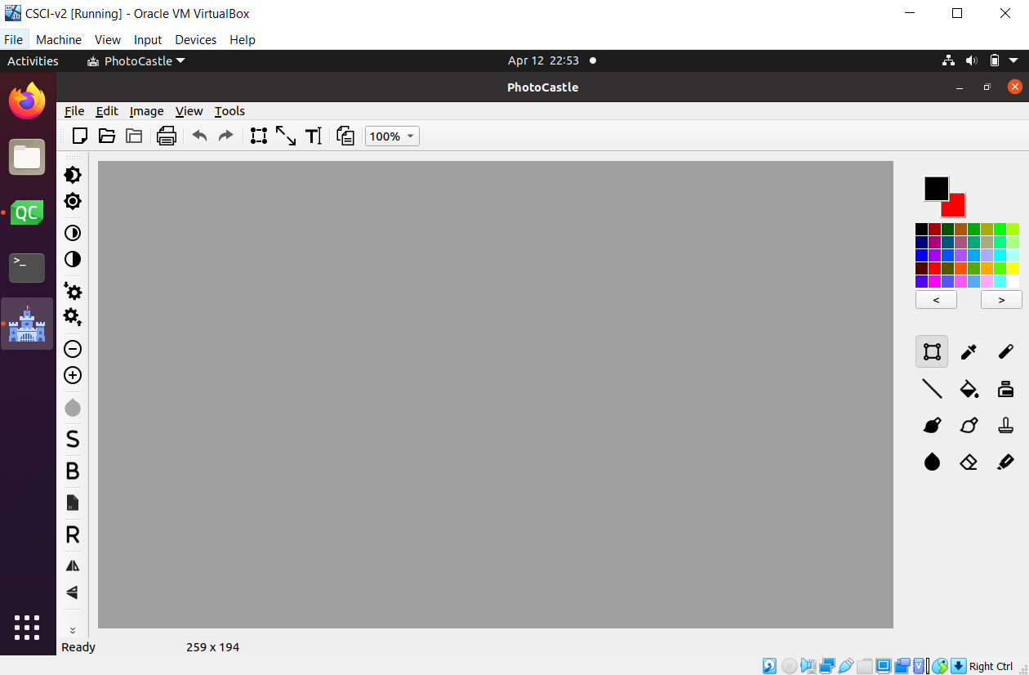
USERS MAIN SCREEN

Slide 9
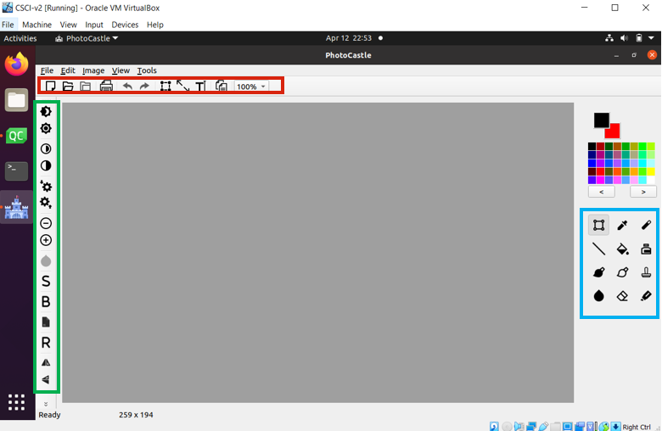
USERS Main screen

Slide 10
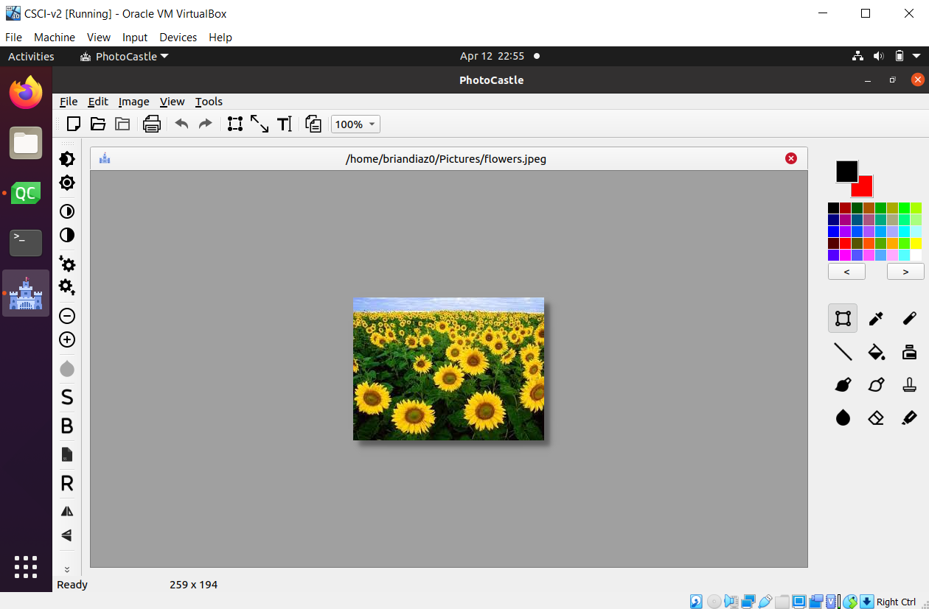
USERS MAIN SCREEN

Slide 11
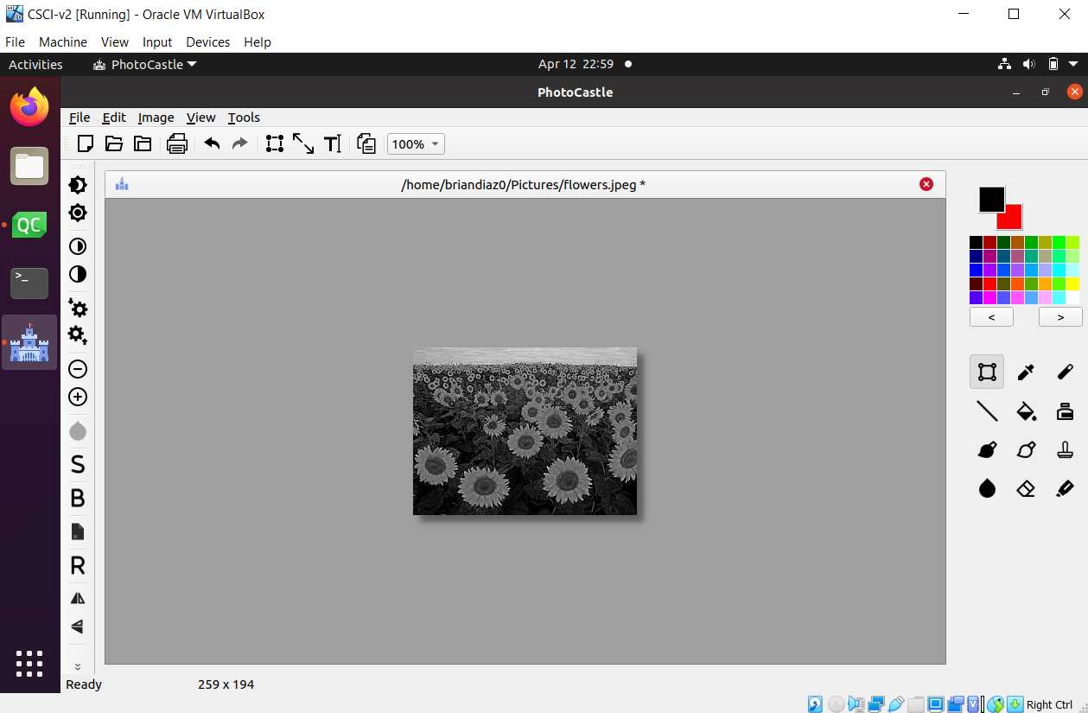
USERS Main screen

Slide 12
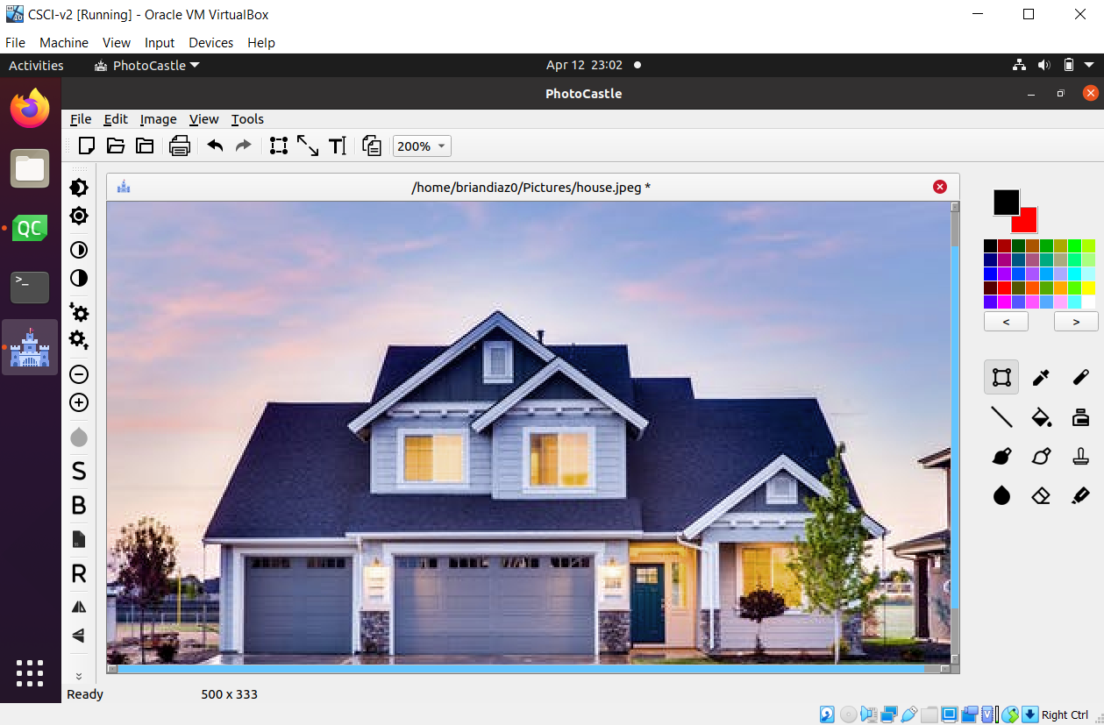
USERS MAIN SCREEN

Slide 13
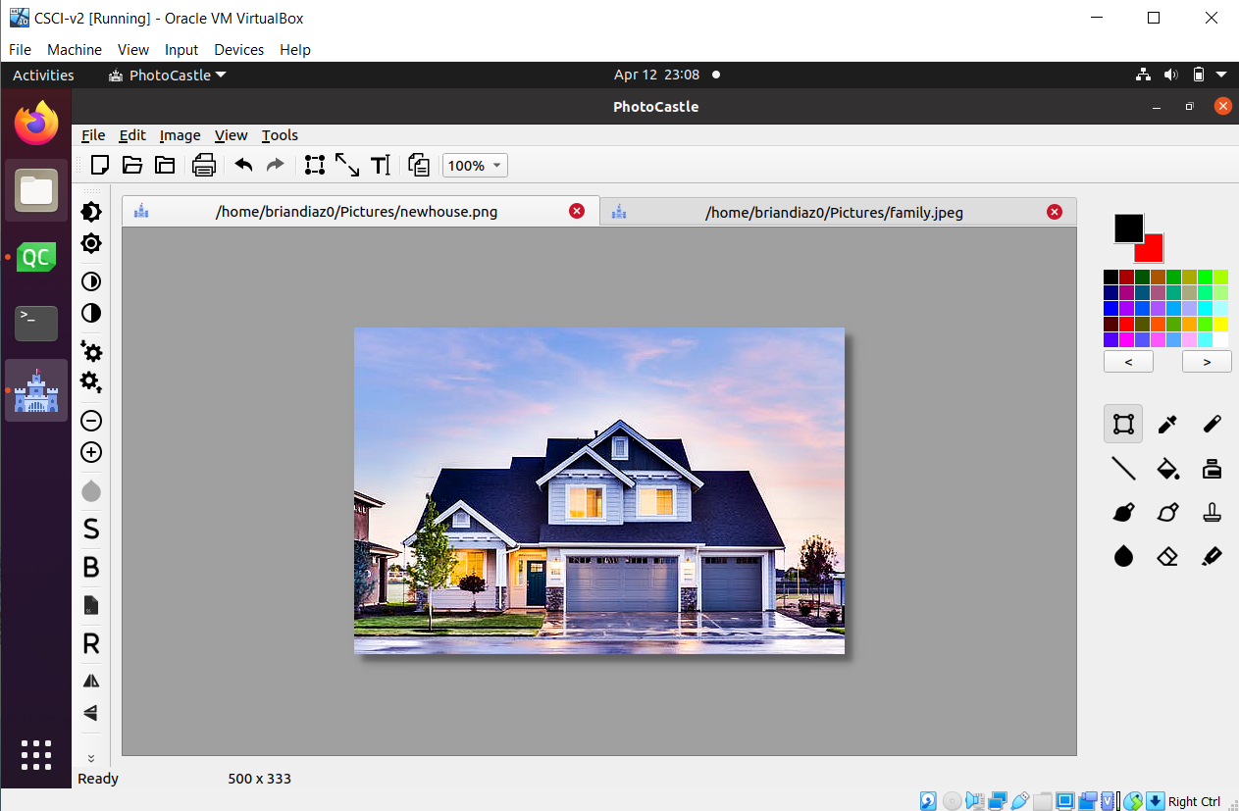
USERS Main screen

Slide 14
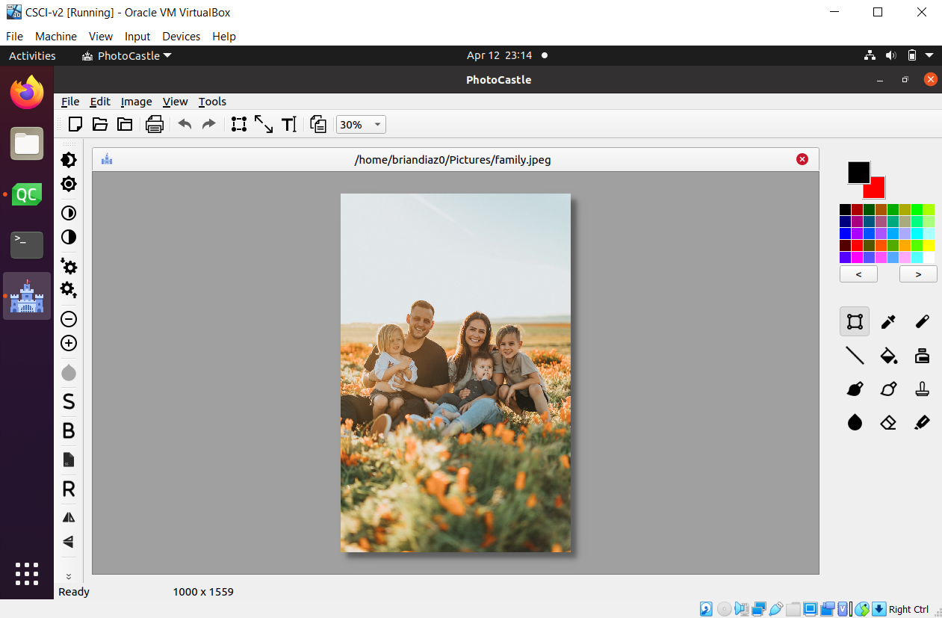
USERS MAIN SCREEN

Slide 15
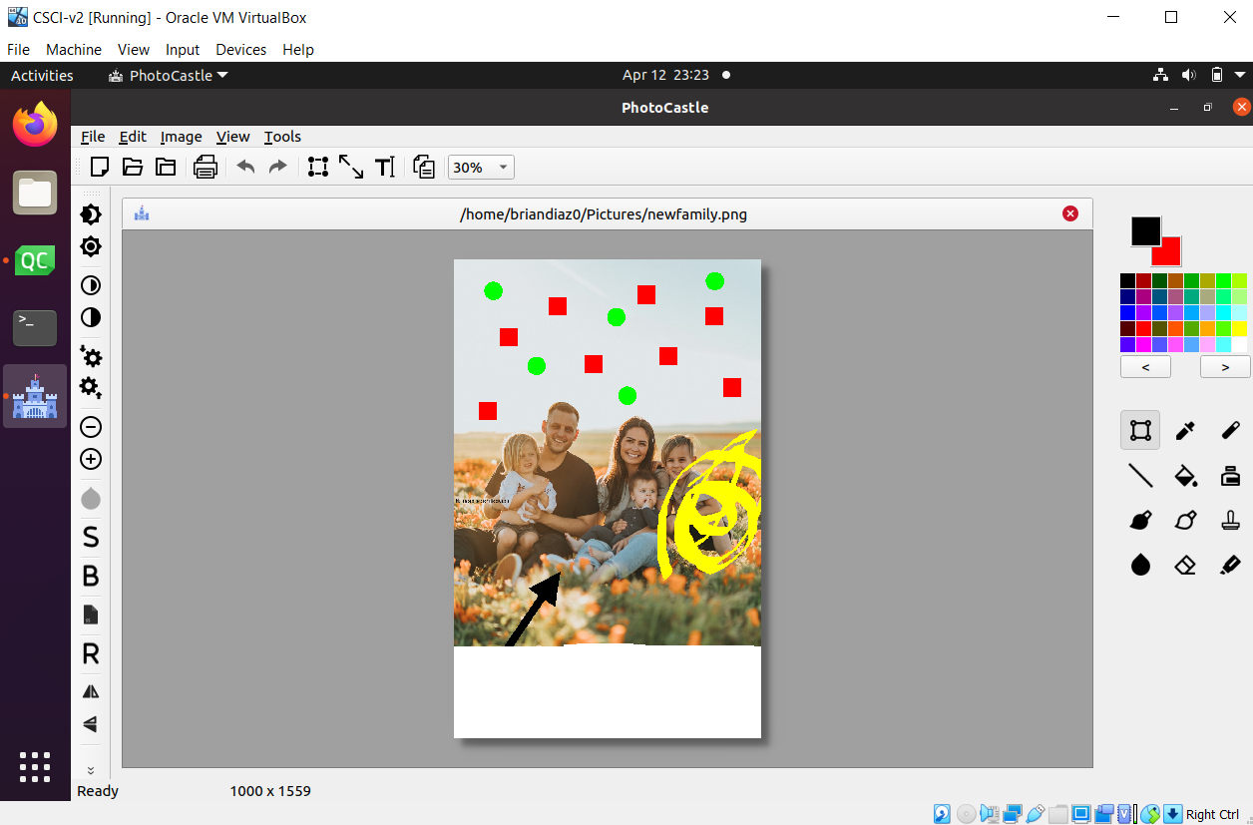
USERS Main screen

Slide 16
OUR Competition
PHOTO CASTLE 1.0
PHOTOSHOP
FOTOSIZER
Our product is priced below that of other photo editing companies on the market.
Simple and easy to build, compared to the complex building materials of Photoshop.
Affordability is the main draw for our consumers as well as having efficiency and simplicity.
Product is more expensive as it requires a monthly membership that stays around $19.99 a month.
Product is complex but can be very efficient if time it taken to learn the tools.
Complexity and efficiency is the main draw here but it comes at a price and the time to consume all the knowledge.
Main Product is free to use however does not include important features which they require a single purchase of around $30.
Simple and easy to use however it is outdated and the UI is not eye-pleasing.
Although it is affordable, it is also inconvenient to use. Their main focus is to produce the required output.

Slide 17
OUR COMPETITION
CONVENIENT
Photoshop
Photo Castle
EXPENSIVE
AFFORDABLE
Fotosizer
INCONVENIENT

Slide 18






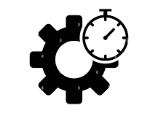

FUTURE ENHANCEMENTS
Include a Dark/Light Mode
Enhance UI to be even more unique and minimal
Introduce Photo Castle Advanced tools for the pros
Become a bigger competitor to Photoshop
Add the tools that couldn’t make it in 1.0
Make the UI for batch photo editing simple
Introduce more efficiency in every tool
Fix all potential crashes and bugs that come up

Slide 19
FUTURE SCHEDULE
How we’ll scale in the future
JUNE 2022
AUGUST 2022
DECEMBER 2022
Roll out drafts to local individuals on Photo Castle 2.0 and make changes based upon feedback
Release the drafts to the general public on Photo Castle 2.0 and make changes based on feedback
Release final version of Photo Castle 2.0 to the general public

Slide 20
THANK YOU
Brian Aguilar Diaz
badiaz@csustudent.net
Photo Castle 1.0

